Slide 1
Swedish Policy Framework and KTH International Strategies

Slide 2
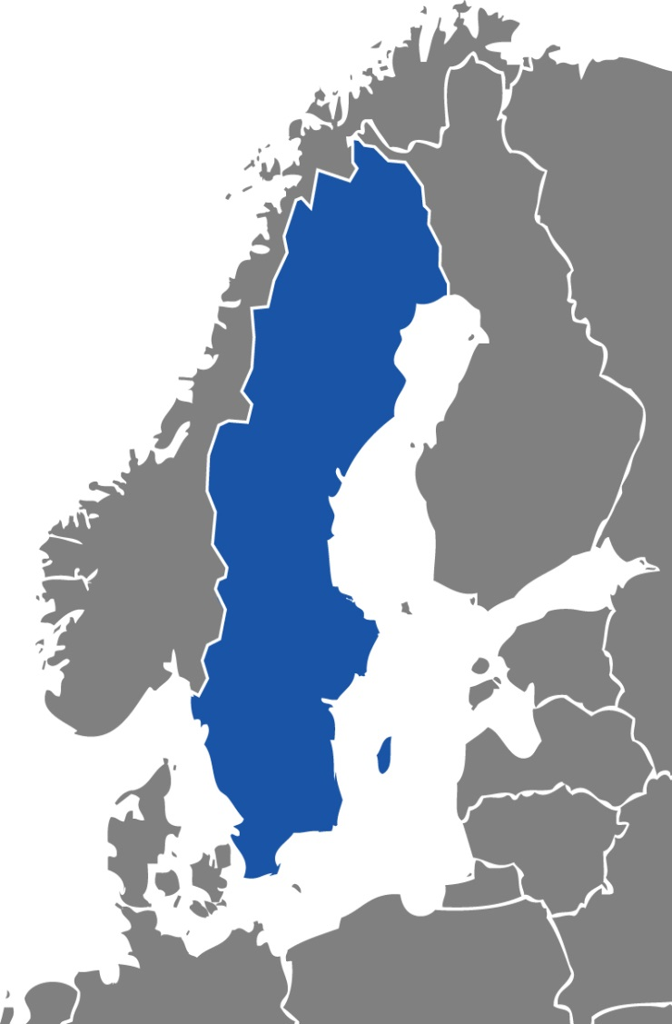

The Kingdom of Sweden
About 10 million inhabitants,
1.3 million of whom live in
the Greater Stockholm area
Has – despite the myths –
a rather pleasant climate
Combines a beautiful natural setting with modern technology
and vibrant cities
Home of the Nobel Prize,
Ikea, Ericsson and many
other famous export companies

Slide 3

Photo: Johnér bildbyrå

Slide 4

KTH in Stockholm
Founded in 1827
Largest of Sweden’s technical universities
Activities housed in central Stockholm since 1917
KTH is present at
Valhallavägen
Kista
Haninge
Södertälje
Flemingsberg

Slide 5
KTH in Stockholm: business as usual
Educates engineers for Swedish Economy
Conducts research together with Swedish companies and research institutes
Funded by the Swedish government through several agencies

Slide 6


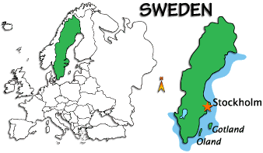










”The world’s most knowledge-based economy” – OECD

Slide 7
KTH in Stockholm: XXI century focus
Educate engineers capable of engineering all over the world
Conducts research together with leading research institutions in the world
Diversified funding for research activities: public, private, national and international
Attracting talented students, researchers and teachers internationally

Slide 8
The Swedish Higher Education Area
35 state institutions
14 Universities
14 University colleges
7 University colleges of Arts
13 ”semi - private” institutions

Slide 9
Internationalization of higher education and research in Sweden: national perspective
”Internationalization at the national, sector and institutional levels is defined as the process of integrating an international, intercultural, or global dimension into the purpose, functions or delivery of postsecondary education” (Jane Knight, Journal of International Higher Education,
no. 33, Fall 2003).

Slide 10
Internationalization of higher education and research in Sweden: national perspective
Main areas which belong to the internationalization:
• Stay abroad of the Swedish students, teachers and other personal
• Internationalization at home
• Recruitment of the programme students from other countries
• International cooperation.

Slide 11
Internationalization of higher education and research in Sweden: national perspective
University autonomy
Bachelor and Master studies are funded by the government for the students coming from EU/EES
Master and PhD studies mainly in English
Tuition fees for the students outside EU/EES
Ministry of Education is responsible for strategies, does not impose the methodology
A variety of public entities which carry out practical work on internationalization

Slide 12
Public entities active in the area of higher education
Swedish Higher Education Authority (UKÄ)
Swedish Council for Higher Education (UHR)
The Swedish Foundation for International Cooperation in Research and Higher Education (STINT)
The Swedish Institute (SI)

Slide 13
Swedish Higher Education Authority www.uka.se
Three main areas
Quality assurance of higher education and appraisal of the degree-awarding powers of public-sector higher education institutions.
Legal supervision of higher education.
Monitoring efficiency, follow-up and horizon scanning as well as responsibility for statistics in the higher education sector.

Slide 14
Swedish Higher Education Authority
Carries out thematic evaluations in Swedish Higher Education:
Survey of the system of tuition fees for third-country students
Student mirror: 9 of 10 students are satisfied with their education
International mobility 2015/16
Internationalization for quality – a university in the world – extensive study of internationalization in Sweden

Slide 15
Swedish Council of Higher Education www.uhr.se
Areas of activity:
Admissions to higher education
  Universityadmissions.se
The Swedish Scholastic Aptitude Test
  Hogskoleprov.nu
Increased diversity, equal rights and widened participation in higher education
Evaluation of foreign qualifications
International cooperation and mobility
Information about higher education
  Studera.nu
Systems administration and support

Slide 16
Swedish Council of Higher Education
International programmes managed by UHR:
ERASMUS+
NordPlus
Linneaus-Palme
Minor Field Studies
Jean Monet

Slide 17
The Swedish Foundation for International Cooperation in Research and Higher Education (STINT) www.stint.se
The Swedish Foundation for International Cooperation in Research and Higher Education, STINT, was set up by the Swedish Government in 1994 with the mission to internationalise Swedish higher education and research
STINT promotes internationalisation as an instrument to:
- Enhance the quality of research and higher education
- Increase the competitiveness of universities
- Strengthen the attractiveness of Swedish universities

Slide 18
The Swedish Foundation for International Cooperation in Research and Higher Education (STINT)
International programmes managed by STINT:
Strategic Grants for Internationalisation
Regional Programmes:
Brazilian-Swedish research collaboration
China-Sweden mobility
Japan-Swedish research collaboration
Korea-Swedish research collaboration
South Africa-Swedish Research collaboration
Initiation Grants
Teaching sabbatical

Slide 19
The Swedish Foundation for International Cooperation in Research and Higher Education (STINT)
STINT Internationalisation Index indicates how international the universities in Sweden are.
This year three universities are in the top category of internationalisation. Last year´s prize winner Stockholm School of Economics is now accompanied by Chalmers and KTH.
The internationalization dimensions:
Research,
Students,
PhD students,
Education,
Faculty
Leadership

Slide 20
The Swedish Institute (www.si.se)
The Swedish Institute is a public agency with a staff of approximately 140 employees, with offices in Stockholm and Paris. It is committed to gaining knowledge and understanding of different cultures, their people, and to promote Sweden and Swedish issues globally.

Slide 21
The Swedish Institute
Areas of operation
Events and projects
Exchange and development programmes
Cooperation in the Baltic Sea region (Visby programme)
Image of Sweden
Information about Sweden
Learning Swedish
Scholarships and grants

Slide 22
Swedish approach and instruments for internationalization of higher education
Focus on quality of the offered educational programmes
Universities make their own decisions
Regular feedback from the institutions to the government
Governmental policies supported by the funding
Joint activities with several institutions/agencies
Funding channeled through various public entities and comes from various ”pockets”: Foreign Affairs, SIDA, regional funds
Regular thematic studies of internationalization by the Swedish Higher Education Authority:
  2005: University without borders?
  2008: A university in the world
  2017: A new extensive study

Slide 23
University without borders? (2005)
Recommendations:
Develop university strategies for internationalization and more prioritize activities in more tangible way
Carry out analysis of the surrounding world in systematic way
Pay more attention on follow-up and evaluation of the internationalization activities
Develop forms for quality assurance of the cooperation agreements
Carry out comparative studies on how the resources dedicated to internationalization are used
Use the university web for efficient promotion of the internationalization work

Slide 24
A university in the world (2008)
Recommendations to the universities - steering:
Internationalization made more visible in the university general documents
Both equal opportunities and diversity shall be visible in the university documents related to the internationalization
The university strategic documents shall be based on information about the institution
The universities shall identify possibilities and pitfalls for internationalization at home and take respective actions
The universities shall develop guidelines for follow-up and quality assurance for internationalization
Universities shall develop their own language policy
Universities shall develop guidelines for follow-up of the contacts between their own teachers and the exchange students
Universities shall develop guidelines for recognition of the studies abroad

Slide 25
A university in the world (2008)
Recommendations to the universities – student exchange:
Universities shall intensify information for students concerning the recognition of the studies abroad
Universities provide high academic value for exchange studies of their own students, especially by involvement of the home teachers and better evaluation of the agreements
The universities extend possibilities for the exchange students to study country’s language and culture
Universities shall develop their work with the information in English about student influence and other rights, handling of the discrimination and other problematic issues

Slide 26
A university in the world (2008)
Recommendations to the universities – agreements:
Universities shall plan how the strategic agreements shall work together or complement exchange agreements
Universities shall have clear vision of the partnership agreements and other forms of cooperation
Universities shall develop quality criteria and clear handling procedures for the agreements and improve the follow-up

Slide 27
A university in the world (2008)
Recommendations to the universities – mobility of teachers:
Universities carry out inventory of the possibilities and pitfalls for mobility of the teachers
Universities intensify and carry out more systematic work on dissemination of the experience of the teachers from the visits abroad
Universities shall define merits for the teacher’s work with the internationalization and that their own mobility influences employment, promotion and determining of the salary level
Universities improve their routines for reporting of the exchange visits of the teachers

Slide 28
A university in the world (2008)
Recommendations to the government:
Promptly create possibilities for Swedish universities to award joint degrees
Consider possibilities for introducing incentives for mobility of the teachers
Support systematic work with Swedish language education for the foreign students having in mind that they are future ambassadors in their home countries

Slide 29
Thematic study 2017
Which recommendations are still relevant?
And
Which of them were useful and taken to account?

Slide 30
THANK YOU

